Slide 1
Presentation of relational RDbms
Developed by : Omar Tebessi

Slide 2
Plan
Definition of MySQL, PostgreSQL and SQL SERVER
Functionalities of MySQL, PostgreSQL and SQL SERVER
Difference between MySQL, PostgreSQL and SQL SERVER

Slide 3
functionalities of MySQL
Relational Database Management System (RDBMS).
Easy to use.
It is secure.
Client/ Server Architecture.
It is scalable, Speed and High Flexibility.
Compatible on many operating systems, Platform Independent, High Productivity and High Performance.
Allows roll-back.
Memory efficiency, Dual Password Support and Partitioning.

Slide 4
functionalities of PostgreSQL
PostgreSQL has many advanced features that other enterprise-class database management systems offer, such as:
User-defined types, Table inheritance and Sophisticated locking mechanism
Foreign key referential integrity
Views, rules, subquery
Nested transactions (savepoints)
Multi-version concurrency control (MVCC)
Asynchronous replication
The recent versions of PostgreSQL support the following features:
Native Microsoft Windows Server version ,Tablespaces and Point-in-time recovery

Slide 5
functionalities of SQL SERVER
Intelligent Query Processing Enhancements.
Accelerated Database Recovery (ADR).
AlwaysEncrypted With Secure Enclaves.
Memory-Optimized Tempdb Metadata.
Query Store Custom Capture Policies.
Verbose Truncation Warnings.
Resumable Index Build.
Data Virtualization With Polybase.
Last Actual Execution Plan DMF.
Multiple Internal Performance Improvements.

Slide 6
Difference between MySQL, PostgreSQL and SQL SERVER
PostgreSQL, and MySQL use very similar syntax, with some notable differences highlighted below. Microsoft SQL Server has the greatest contrast in SQL syntax, as well as a wide variety of functions not available in other platforms. The table below highlights some examples of basic differences between SQL platforms.

Slide 7
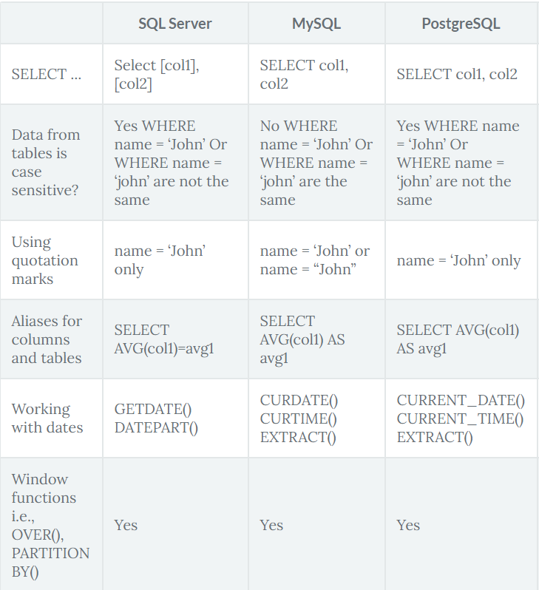
Difference between MySQL, PostgreSQL and SQL SERVER

Slide 8
thank you for your attention

